Slide 1


RI Club & District Support
Navigating Serious Concerns with Confidence
Cassie Howder
Youth Safety & Culture Manager, Americas, Rotary International
Far West PELS 2025
Notes:
Welcome everyone to the RI Club & District Support Session.
My name is Cassie Howder — Youth Safety & Culture Officer, Rotary International.
[0–7 MIN: Welcome & Framing]

Slide 2
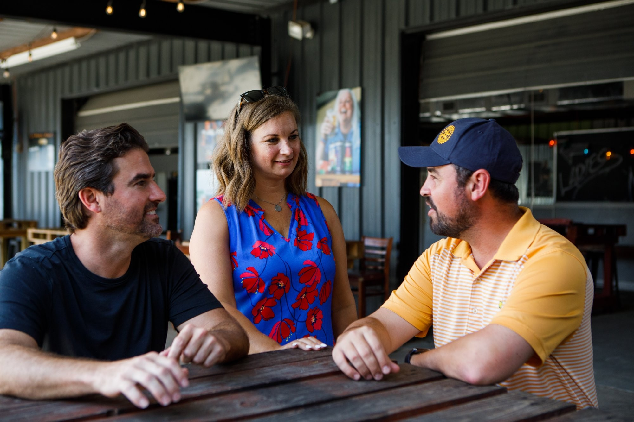
ROTARY CODE OF POLICIES — SECTION 26.120
“
All members and individuals attending or participating in Rotary meetings, events or activities should expect an environment free of harassment and shall help maintain an environment that promotes safety, courtesy, dignity, and respect to all.
Today's goal: ensure you feel confident knowing the first steps — and where to turn for support.
Notes:
The content covered today really centers around this article of RI's code of policies.
Can I get a volunteer to read it?
So, we will be talking about both youth safeguarding & adult harassment situations today. My goal is to help you feel even a bit more confident navigating those situations and you should leave today knowing:
• A few proactive practices to strengthen club culture
• The first steps to take when serious issues arise in your club
(Change slide) And who you can contact for guidance.

Slide 3
YOU ARE NOT ALONE
Notes:
With that, I'd like to introduce you to three teams at Rotary International that are uniquely positioned to support you as club presidents.

Slide 4

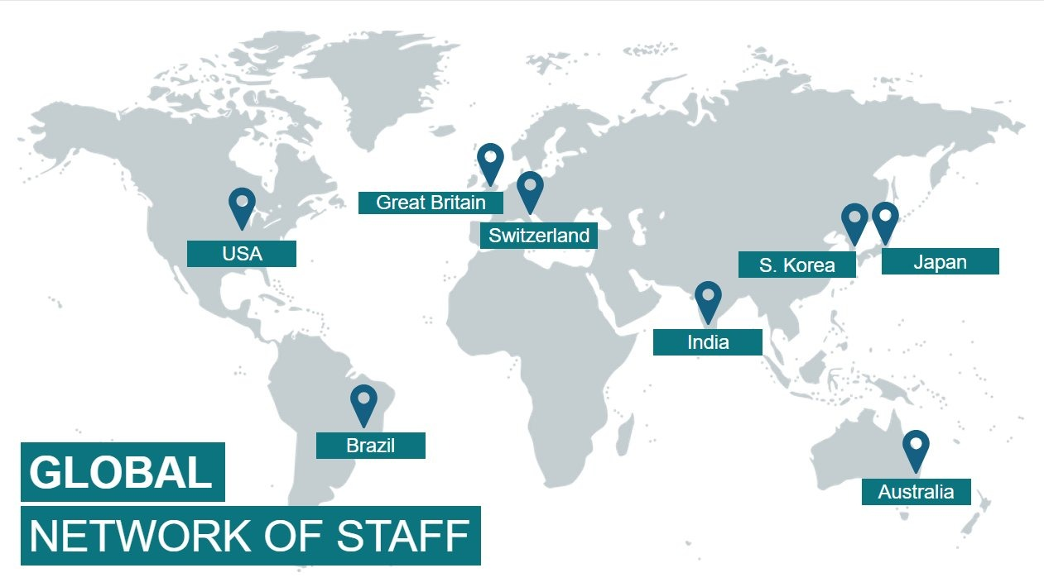
ROTARY INTERNATIONAL — GLOBAL NETWORK OF STAFF
RI Club & District Support | Far West PELS 2025
Notes:
Ask: "Any guesses how many staff Rotary International has?"
Answer: ~700 staff worldwide, with most based near our headquarters in Evanston, Illinois, and others working from our seven international offices around the world.

Slide 5
ROTARY SUPPORT CENTER
Your first point of contact for general Rotary questions.
CONTACT
📧
rotarysupportcenter@rotary.org
Available to help with:
General Rotary questions
IT or MyRotary issues
Donations or recognition questions
Connecting you to the right RI team
📞
866-976-8279
Toll-free | Mon–Fri, 8am–5pm CT
When in doubt — call first.
They will help you triage.
RI Club & District Support | Far West PELS 2025
Notes:
One of the largest teams at RI is the Rotary Support Center — which is our main help desk for members.
Use when:
• You need a quick answer
• IT or MyRotary issues
• Donations / recognition Qs
• Or any other general questions about Rotary
When you're not sure who to contact at RI — always start with the Rotary Support Center and they will direct you to the right place.
Quick show of hands: "How many of you already knew Rotary had a call center?"

Slide 6
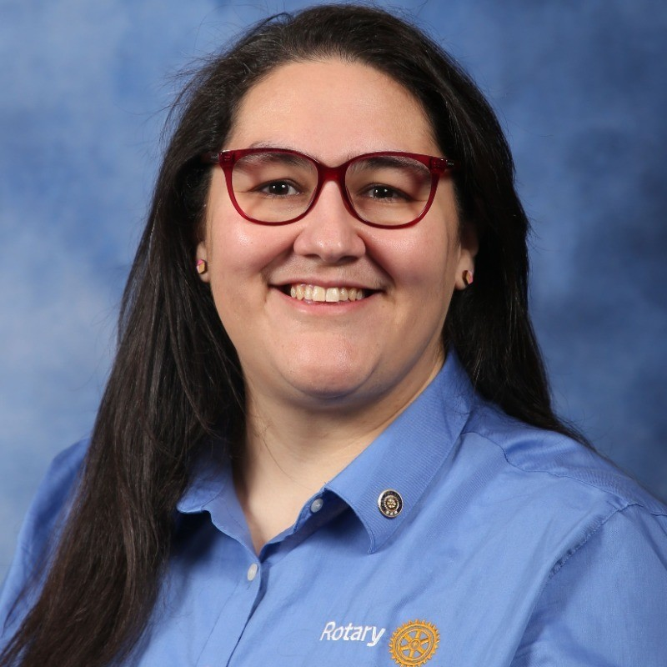
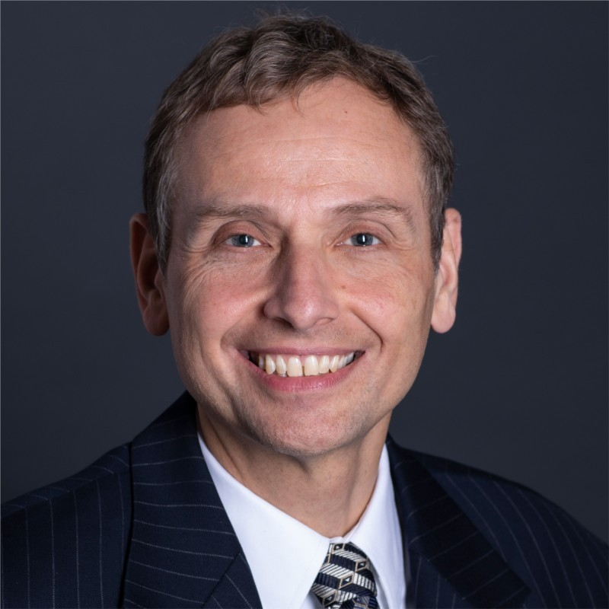

MEMBERSHIP GROWTH & EXPERIENCE (MGX) — ZONES 25B, 26 & 27
Haris Sofradzija
Membership Growth Officer
Zones 25B, 26 & 27
Angela Lopez
Supervisor, Membership Growth & Experience
Zones 25B, 26 & 27
Club Experience Officer
Vacant Position
Contact Haris or Angela in interim
They support with: Membership growth • Club flexibility • Governance questions • Challenging club situations • Mergers, satellites & new clubs
RI Club & District Support | Far West PELS 2025
Notes:
Next is the Membership Growth & Experience team, often called MGX.
For your region — which includes Zones 26, 27, and 25B — that team includes Haris and Angela.
Haris some of you will meet next / may recognize from the membership session today.
The vacant role you see here is actually the role I previously held at RI — and we expect to be refilling it very soon.
These three provide region-specific support to C&D leaders, with things like:
• Membership growth
• Club flexibility
• Policy & governance questions
• Challenging club situations (that don't rise to level we'll discuss today)
• Mergers / satellites / new clubs
They work very closely with district leadership and are also a great resource for presidents if ever you need help with anything listed along the bottom of the screen. :)

Slide 7
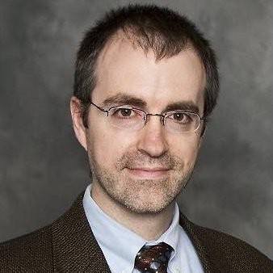
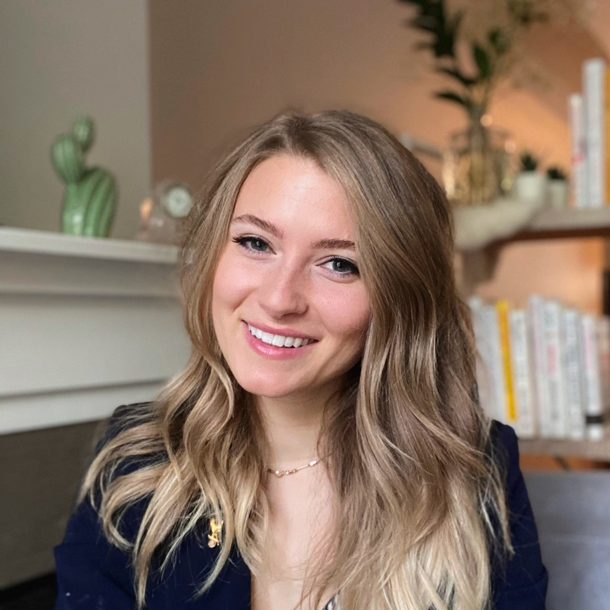
CULTURE & VALUES TEAM — AMERICAS
Youth safeguarding
Adult harassment claim guidance
Preventative coaching & resources
WHAT WE DO
CONTACT US:
Youth safety:
youthprotection@rotary.org
or: rotaryyp.caseiq.app/portal
Adult harassment/misconduct
cultureandvalues@rotary.org
David Peterson
Culture & Values Manager, Americas
david.peterson@rotary.org
+1 (847) 866-3393
Cassie Howder
Youth Safety & Culture Manager, Americas
cassie.howder@rotary.org
+1 (815) 800-8167
RI Club & District Support | Far West PELS 2025
Notes:
The final team I'll mention is Culture & Values, which is the team I transitioned into earlier this year.
We're a team of 10 who support clubs and districts worldwide with:
• All things relating to Youth safeguarding — including responding to any concerns or incidents reported to RI
• Support and guidance on addressing adult harassment claims
• Preventative coaching and resources to help foster more inclusive, safe, and welcoming environments
You're always welcome to contact David or me directly.
However, I recommend including our team email as well to ensure the fastest support. While David and I specifically support the Americas region (about 200 districts), copying the team email allows more people to see the request. Our team of 10 works very collaboratively and often helps support one another's regions.
Key Takeaway: Keep in mind you have support people at the club, district & Rotary International level.

Slide 8
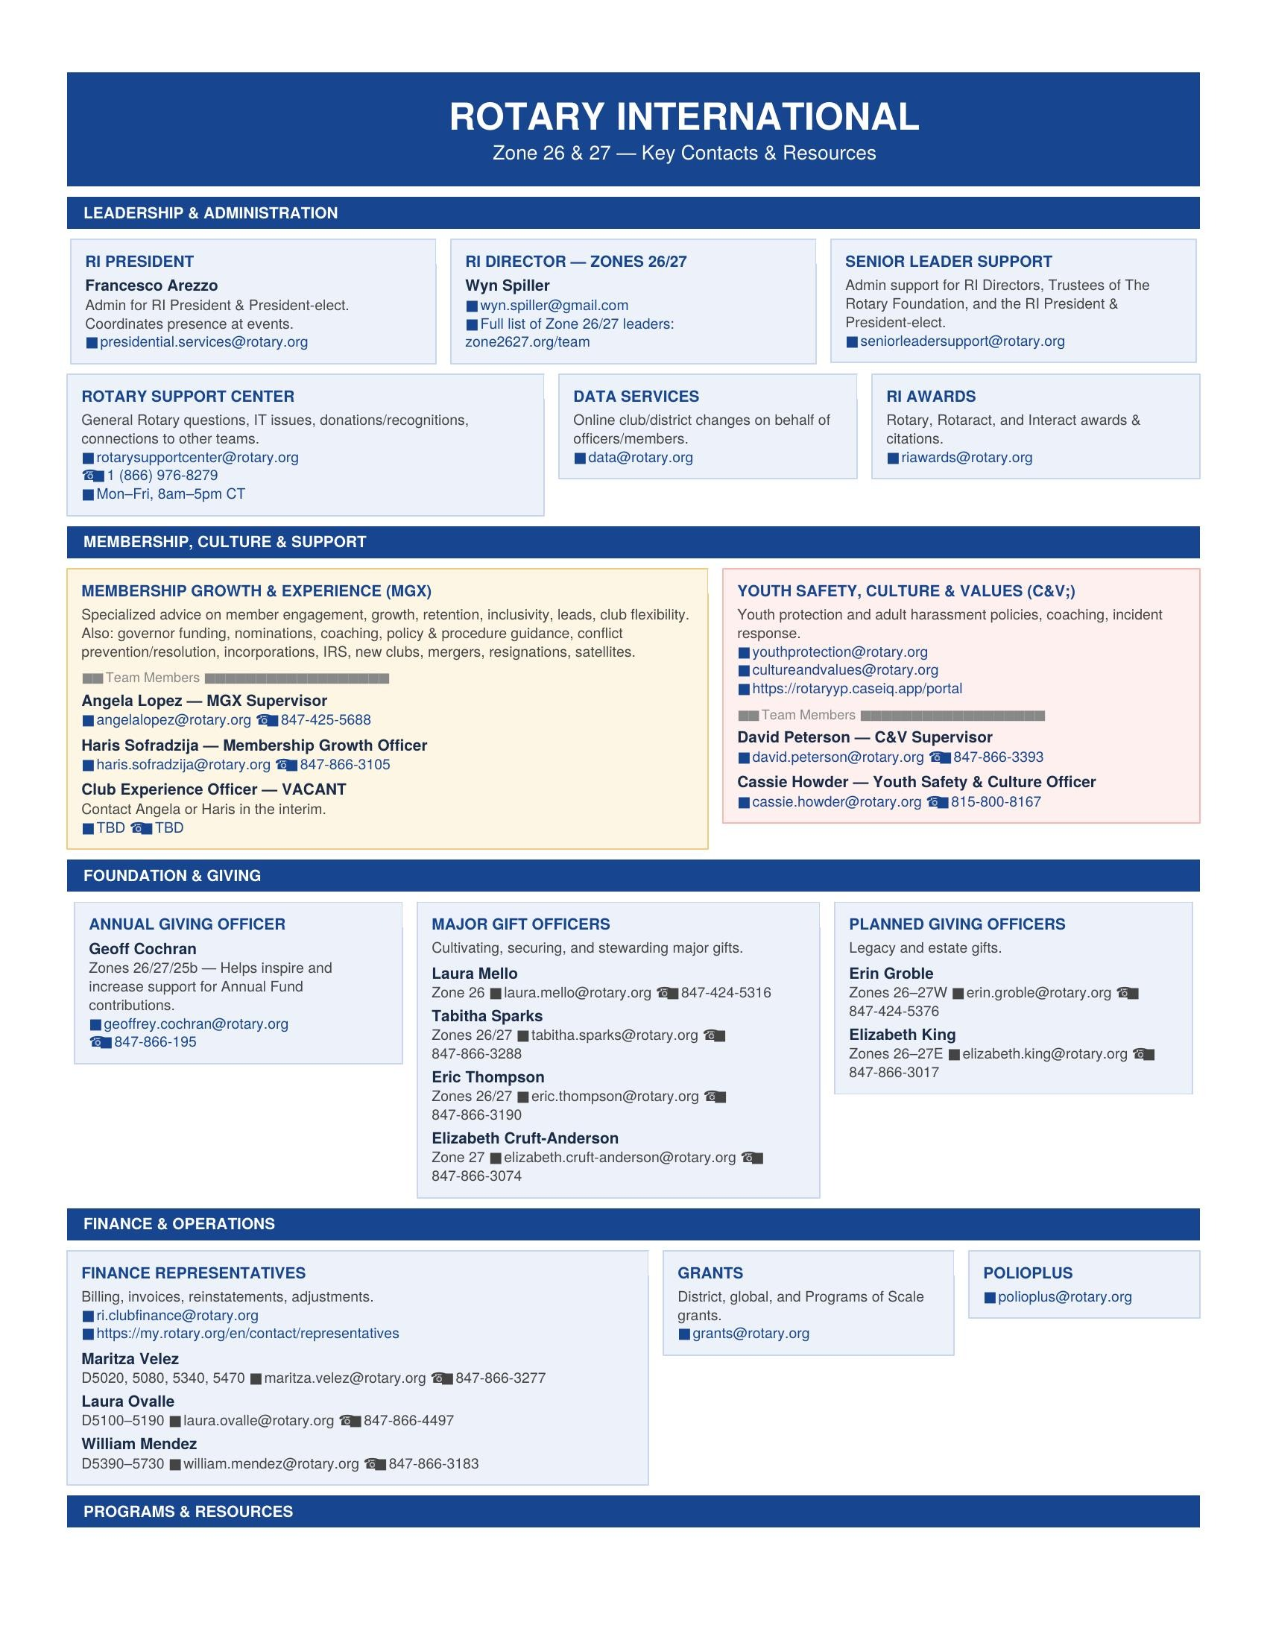
ZONE 26 & 27 CONTACT SHEET RESOURCE
YOU WILL RECEIVE THIS
A full contact sheet for your zone — covering every RI team that supports clubs and districts in Zones 25B, 26 & 27.
Includes:
Leadership & Administration
Membership & Culture teams
Foundation & Grants
Finance, Programs & more
RI Club & District Support | Far West PELS 2025
Notes:
After the session, I'll be sharing this RI contact sheet I made specifically for your region — it includes the previously mentioned teams and several others you might work with, such as insurance, branding, the Foundation, and many others.

Slide 9
PREVENTION:
CULTURE & STRUCTURE
Notes:
[Transition to Prevention section]

Slide 10
SETTING YOUR CLUB UP FOR SUCCESS
01
02
03
Build a Culture of Safety & Inclusion
Have a Plan Before You Need One
Strengthen Your Club's Infrastructure
Proactively foster a club environment where all members feel respected, valued, and safe to raise concerns.
Establish clear, agreed-upon steps for addressing conflict or concerns — so you're not improvising in the moment.
Ensure your governing documents, policies, and procedural resources support a culture of accountability and care.
RI Club & District Support | Far West PELS 2025
Notes:
[7–15 MIN: Prevention: Culture + Clarity + Structure]
Next, I have 3 proactive ideas to help you set your club up for success and better equip them to confidently and constructively address serious issues that arise.
Starting with #1 here — Building a culture of safety, inclusion, respect.

Slide 11
PROACTIVE PRACTICES FROM AROUND THE WORLD
🌍 West Africa
🇪🇺 Europe
5-Minute End-of-Meeting Reflection
Ethics Committees & Neutral Advisors
One club noticed unresolved tensions were affecting club atmosphere and contributing to member resignations.
They began dedicating the final five minutes of each meeting to a brief, members-only reflection — creating a regular space to respectfully surface concerns.
Result: conversations became more constructive and membership turnover decreased.
Many clubs in Europe have established small committees or designated trusted members to address lower-level conflicts:
🇫🇷 France: clubs use a “Wise Committee” of trusted members as confidential advisors.
🇳🇱 Netherlands: Rotarians with professional mediation or counseling experience serve as confidential advisors when issues arise.
📋 You will receive a resource after today with more real-life tactics being used by clubs around the globe.
RI Club & District Support | Far West PELS 2025
Notes:
My colleagues in Rotary's Europe/Africa office consolidated some of the top best practices being used in their region to manage conflict more effectively.
This is another resource I'll be providing you after today's session. It has a ton of great ideas for your club to consider.
For today — I've highlighted two themes for us to look at.
Can I get a volunteer to read #1?
[Five-Minute End-of-Meeting Reflection]
Love it — sometimes the smallest shift can make a huge impact.
Can I have someone read #2?
[Ethics Committees or Neutral Advisors]
The key here is that there are endless ideas around building more positive cultures in clubs. I encourage you to review the other real-life practices in the PDF I will share with you and decide if anything might have an impact on your club.

Slide 12
ROTARY LEARNING CENTER — learn.rotary.org
PART OF THE CLUB PRESIDENT ESSENTIALS II LEARNING PLAN
🛡️
Preventing & Addressing
Harassment
👦
Protecting Youth
Program Participants
Step-by-step guidance on handling formal harassment complaints — definitions, response process, and required actions.
Covers youth protection policies, mandatory reporting obligations, and how to respond to concerns involving minors.
ALSO GREAT FOR A CULTURE OR CONFLICT COMMITTEE:
Fostering Engagement and Belonging
Essentials of Understanding Conflict
Uncovering Unconscious Bias
Microaggressions
💡 Tip: Assign these courses to your entire board before your year begins.
RI Club & District Support | Far West PELS 2025
Notes:
The next proactive tip lives in the Rotary Learning Center.
RI has put a lot of resources and brilliant minds into improving older courses, making new, relevant and high-quality content, and launching a mobile app which makes taking these courses more accessible.
Minimum recommendations (most relevant to today, already in your President Essentials II learning plan):
• Preventing and Addressing Harassment
• Protecting Youth Program Participants
These courses explain step-by-step procedures for both serious adult and youth situations.
I've listed several other relevant courses that you or your board may find helpful — especially if you decide to establish a committee focused on culture or conflict resolution.

Slide 13
REVIEW YOUR CLUB BYLAWS
WHY IT MATTERS
Defines how your club operates day-to-day
Outdated bylaws can create gaps when serious issues arise
Clear bylaws provide a fair, consistent process to follow
Keeping them current ensures your structure reflects your membership's needs and culture
Contact your MGX team (Angela or Haris) for guidance on reviewing or updating your bylaws
CLUB
BYLAWS
RI Club & District Support | Far West PELS 2025
Notes:
The final proactive tip: review club bylaws.
Clubs follow the Standard Rotary Club Constitution, but many operational decisions are defined locally.
Keeping bylaws current helps ensure:
• Club structure matches current culture
• Clear processes exist if conflicts arise
Worst time to figure out a process: after a serious issue occurs.
Contact Haris or Angela if you need help getting started.

Slide 14
ADULT HARASSMENT
FRAMEWORK
Notes:
Now let's look at the main steps to keep in mind if an adult harassment concern is raised in your club.
[15–20 MIN: Adult Harassment Framework]

Slide 15
HOW ROTARY DEFINES HARASSMENT
Rotary Code of Policies — Section 26.120: Harassment-Free Environment at Meetings, Events, or Activities
“
Rotary is committed to maintaining an environment that is free of harassment. Harassment is broadly defined as any conduct, verbal or physical, that threatens, denigrates, insults or offends a person or group based on the following characteristics: age, ethnicity, race, color, disability, religion, socioeconomic status, culture, sex, sexual orientation, or gender identity.
POLICY DISTINGUISHES THREE CATEGORIES:
Sexual Harassment / Abuse
Severe &/or Pervasive Harassment
Other Inappropriate Conduct
RI Club & District Support | Far West PELS 2025
Notes:
We'll start by briefly reviewing how Rotary defines harassment in policy — as not every uncomfortable situation will meet that threshold.
The reason this matters is that when behavior appears to align with this definition, then specific guidelines and procedures outlined in Rotary policy come into play.
Could I have someone volunteer to read this definition for us?
THANK YOU — next slide.

Slide 16
HARASSMENT: REQUIRED ACTIONS & CONSEQUENCES
IF FOUND TO HAVE ENGAGED IN:
IF CONDUCT DOES NOT RISE TO THAT LEVEL:
Sexual harassment or abuse
Severe and/or pervasive harassment
Other Inappropriate Conduct
Club may choose appropriate corrective action:
REQUIRED CONSEQUENCES:
Required training or education
Behavioral agreement
Mediation
Removal from leadership roles
Suspension or termination of membership
Terminate membership
Notify RI
Individual ineligible for future membership
Barred from youth program participation
RI Club & District Support | Far West PELS 2025
Notes:
One final point: Rotary policy mandates certain consequences depending on the type and severity of harassment that is found to have occurred.
If an individual is found to have engaged in sexual abuse or severe and/or pervasive harassment, the club is required to notify Rotary International so the individual can be made ineligible for future Rotary membership and barred from participation in youth programs.
If the conduct does not rise to that level, the club may choose appropriate corrective actions. Some examples are listed here.

Slide 17
ADULT HARASSMENT: RESPONSE STEPS
1
2
3
Ensure Safety
Assess the Situation
Bring to RI
Prioritize the safety of all involved.
If a law may have been broken, report to local authorities.
Using your best judgment, determine whether the concern may meet the threshold of harassment as defined by Rotary policy.
You are not expected to investigate.
If it appears to meet the threshold, contact the Culture & Values team:
cultureandvalues@rotary.org
Copy your District Governor.
From there, RI will confirm the threshold and guide next steps:
→ Review → Report of findings → Corrective/disciplinary action
RI Club & District Support | Far West PELS 2025
Notes:
These are a few very high-level steps we recommend when a serious adult harassment concern is brought to your attention:
1. Ensure the safety of everyone involved. If you believe a law may have been broken, the situation should also be reported to local authorities.
2. Based on the information you receive, determine whether the concern may meet the threshold of harassment as defined by Rotary policy. You're not expected to investigate at this stage — just use your best judgment based on the initial information available.
3. If the situation appears to meet the threshold of a formal harassment concern, contact David and I at cultureandvalues@rotary.org and copy your District Governor for awareness. From there — we will help confirm whether the situation meets the policy threshold and guide you through the next steps, which typically include:
• Conducting a review
• Preparing a report of findings
• Implementing any necessary corrective or disciplinary actions
KEY MESSAGE: When in doubt, don't hesitate to contact your District leaders and our teams at RI — as that will help protect the victim, you, your club, and Rotary.

Slide 18
YOUTH SAFETY
FRAMEWORK
Notes:
[20–25 MIN: Youth Safety Framework]

Slide 19
YOUTH SAFETY: RESPONSE STEPS
1
2
3
Ensure Safety
Report to RI Within 72 Hours
Remove Alleged from Youth Contact
Reassure the young person.
Gather basic facts — without interrogating.
Report any illegal activity to law enforcement.
Required by policy — failure has mandatory consequences.
Notify district leadership (DG).
Primary: rotaryyp.caseiq.app/portal
Alternative: youthprotection@rotary.org
Immediately suspend the individual from all contact with youth until the situation is reviewed.
RI will then help assess and guide next steps.
⚠️ You are not the investigator — your role is to ensure safety and that the concern is reported and handled appropriately.
RI Club & District Support | Far West PELS 2025
Notes:
The response steps for youth safety concerns are very similar to those for adult harassment, but there is one important difference.
Rotary policy requires that youth safety concerns be reported to Rotary International within 72 hours. Failure to do so can result in serious consequences, including possible club termination.
When a youth concern is raised:
• Ensure the young person is safe, gather basic facts, and report any illegal activity to law enforcement.
• Report the concern to RI within 72 hours and notify district leadership.
• Remove the accused individual from contact with youth until the situation is reviewed.
From there, RI will help assess and guide next steps.
As with adult harassment cases, remember that you are not the investigator — your role is to ensure safety and that the concern is reported and handled appropriately.

Slide 20
SCENARIO ACTIVITY — LET'S PRACTICE
Scenario 1
Scenario 2
Scenario 3
New Member Concern
Unwanted Physical Contact
Youth Communication
A new female member feels uncomfortable after an older member makes unsolicited comments and physical contact at a club social. The behavior continues at a second event, leaving her feeling unsafe.
After a club event, a member is grabbed and kissed without her consent while alone in a parking area. She contacts the club president the next day, asking to be kept separated from the individual.
A 17-year-old youth program participant tells a volunteer that a Rotarian has been sending her late-night private messages that became increasingly personal and uncomfortable.
Discuss: What is your first priority? • Who do you call? • What additional info do you need? | Focus on process, not determining guilt.
Notes:
[25–55 MIN: Scenario Activity]
Alright, that concludes the overview portion of the session. Now we're going to transition into an activity where you'll apply what we've discussed.
Each group will receive a short scenario based on real-life situations. In small groups of three or four, you'll discuss how you might respond if something like this happened in your club.
A few quick instructions:
• Start by having one person read the scenario aloud together.
• Have another person act as a quick note-taker for your group.
• Then discuss the questions listed on the sheet.
Focus on the process you would follow as club leaders — not determining whether someone is guilty or innocent.
While I hand these out, please begin forming groups of three people, starting on this side of the room. The final group may have four.
-- After handing out --
Remember — focus on the steps you would take, not solving the case. Timer starts now.
DEBRIEF:
Alright everyone, let's bring the room back together. Please wrap up the thought you're finishing.
[Pause]
I'll ask one group to briefly share how they approached it, and then we'll hear if any other groups had a different perspective.
Is there a group who tackled Scenario 1 that would like to share their approach?
Debrief questions:
• "Did another group approach this differently?"
• "Did anyone prioritize something different as the first step?"
Key learning point: When potential criminal conduct is involved, prioritize safety and contact local authorities — don't investigate internally.
Best practices to share if missed:
• Document early: what was reported, when, and what steps were taken.
• Avoid resolving serious issues privately — consultation is key.
Time saver — if debate about whether behavior counts as harassment:
"That's a great question, and one reason why consulting district leadership or RI can be helpful. Today we're focusing on the steps leaders should take when concerns are raised."
Total time per scenario: 5–6 minutes.

Slide 21
WHEN SERIOUS CONCERNS ARISE
01
02
03
Safety First
Consult Early
Trust the Process
The physical and emotional safety of everyone involved — especially the person who came forward — is always the first priority.
Reach out to your DG and the C&V team before you act. You are not expected to figure this out alone.
Follow the formal process faithfully — it protects you, the club, and ensures a fair outcome for everyone.
RI Club & District Support | Far West PELS 2025
Notes:
[55–60 MIN: Closing]
Main things to remember when concerns like this arise:
• Prioritize safety
• Consult the right people early
• Follow a fair, documented process

Slide 22
FINAL REFLECTION
“
What is one proactive step you will take before July 1?
Take a moment to write it down. We’ll share a few before we close.
Notes:
Ask: "What is one proactive step you will take before July 1?"
Take 2–3 responses.

Slide 23
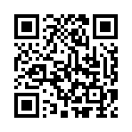
SESSION EVALUATION
Please take a moment to complete the evaluation for this session.
RI Club & District Support
Presented by Cassie Howder
RI Club & District Support | Far West PELS 2025
Notes:
Finally — please take a moment to complete the brief questions on this survey about this session.
CLOSING MESSAGE:
I'll end today by saying that conflict is natural in organizations made up of passionate people. What matters most is that we address concerns early, respectfully, and with the support systems Rotary has in place.
Thank you all for your time and attention today. 😊
MATERIALS TO SHARE AFTER SESSION:
• Europe/Africa prevention examples PDF
• RI Contacts Resource

Slide 24
Thank You
Cassie Howder
Youth Safety & Culture Manager, Americas, Rotary International
cassie.howder@rotary.org
Questions? I'm here.
Notes:
Open the floor for questions.
Your DG, the MGX team, and the C&V team are all available. No question is too small — calling early is always the right move.

